Slide 1
Hardy Roses for Southeast Wisconsin
By Larry Heebsh
rosebug198@gmail.com

Slide 2
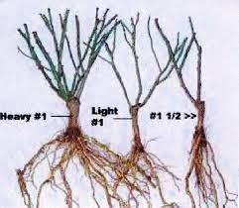
Always buy the best bush you can from a quality garden center or mail order source.
Grade 1 roses should have at least 3-4 canes the size of a pencil or larger.
Buying Tips

Slide 3
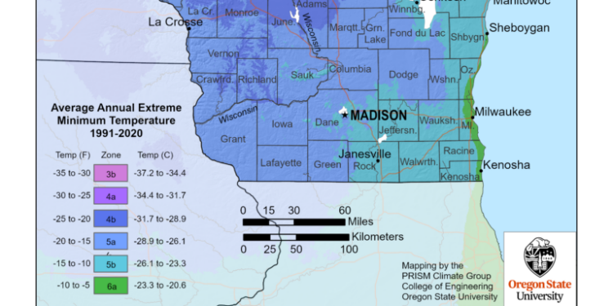
We reside in plant hardy zone 5B-6A

Slide 4
The roses presented here are a collection of plants that are either locally available or from mail order sources.
While most of these roses are shrubs or old garden roses, because of climate change in recent years we can enjoy growing plants that previously were only hardy in warmer zones.

Slide 5
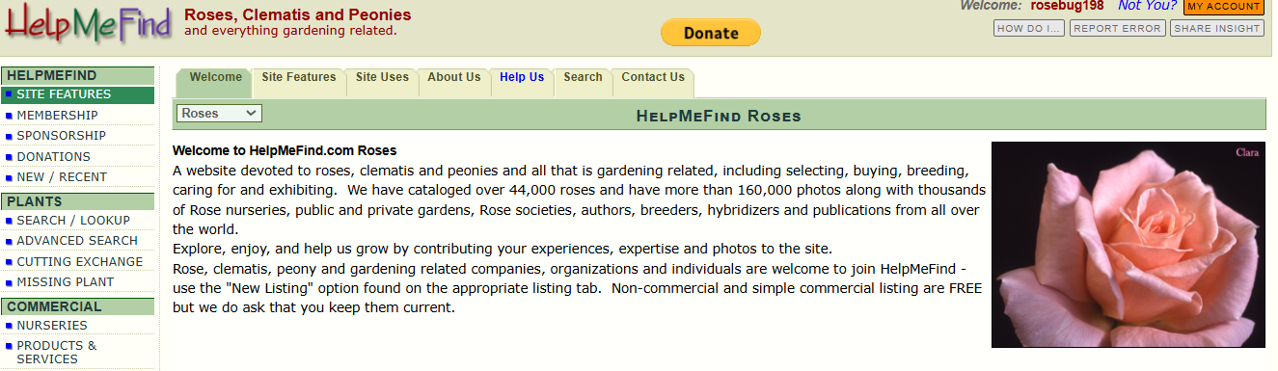
Helpmefind.com

Slide 6
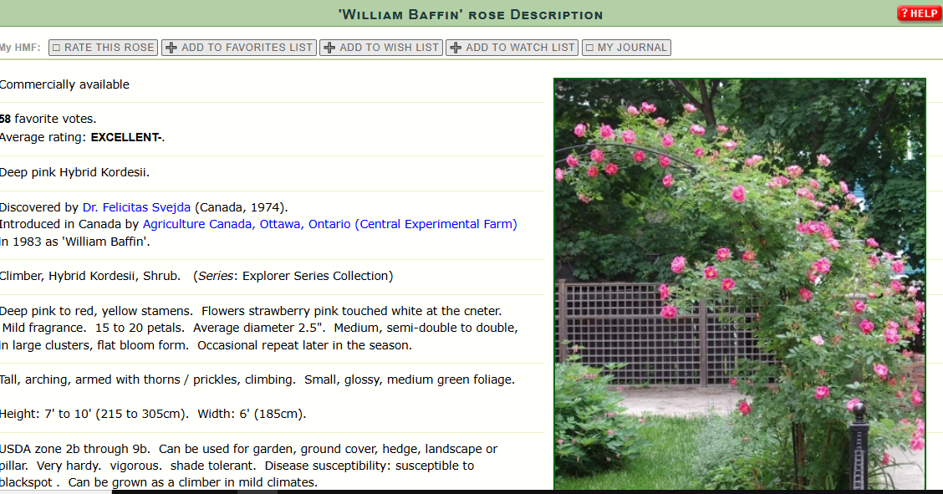

Slide 7
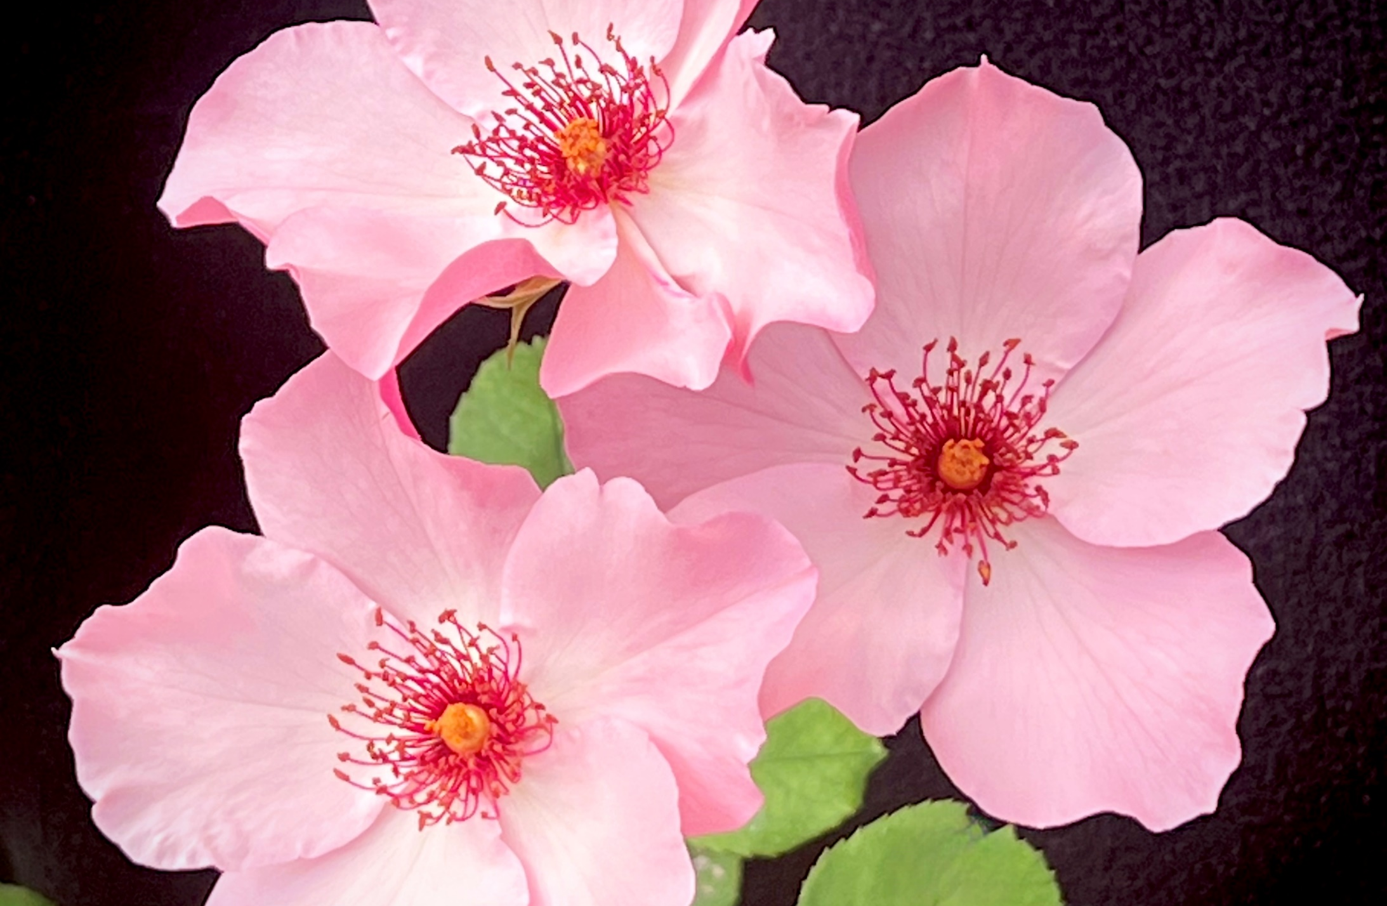
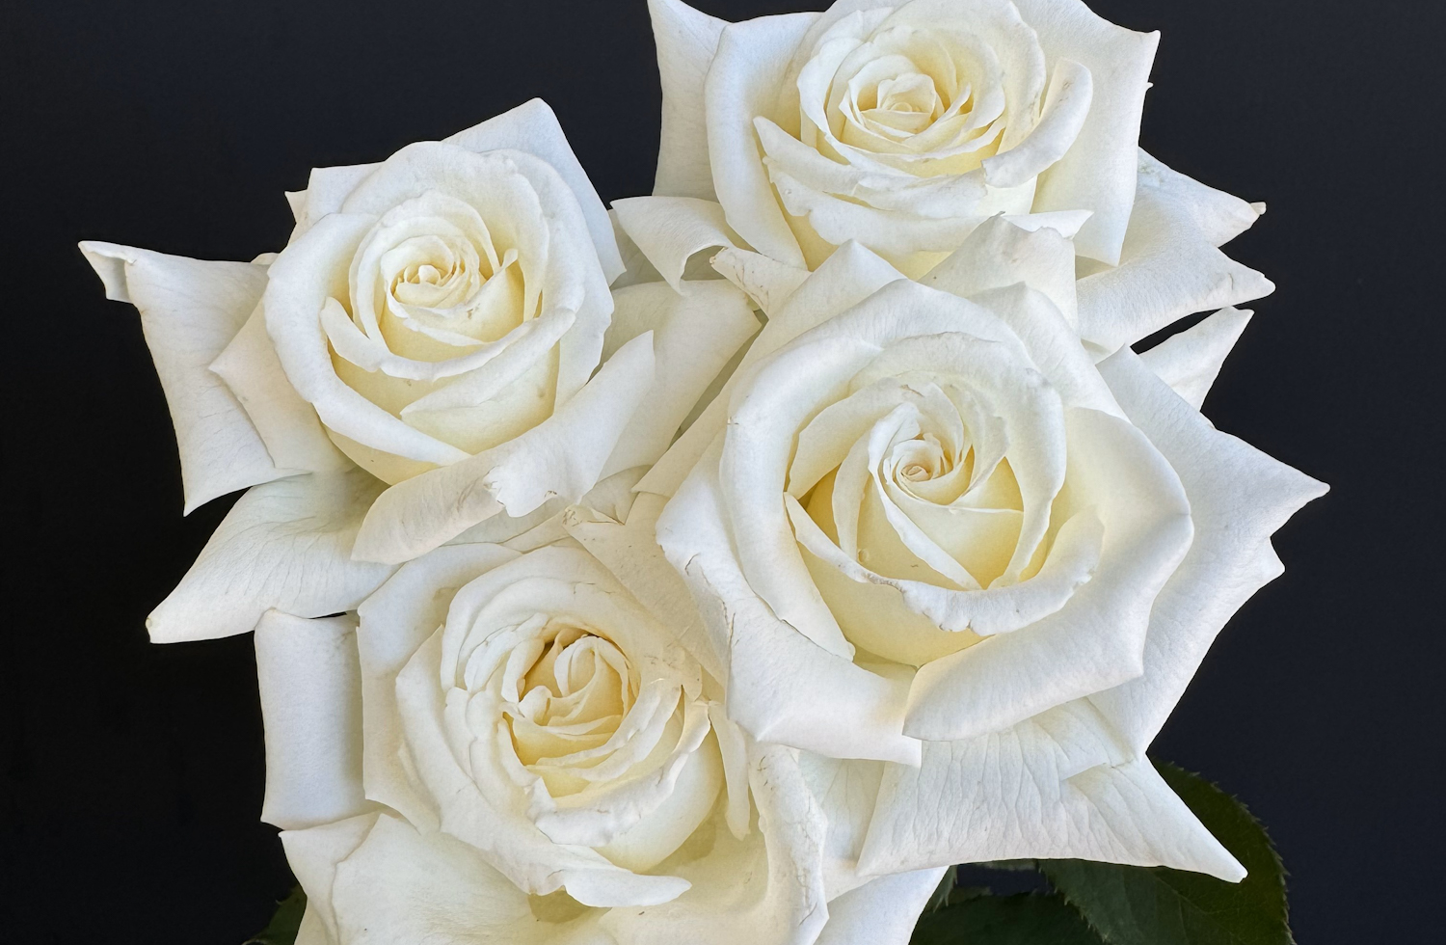
Hybrid Tea Roses
Dainty Bess
8.4 4B zone
Pope John Paul II
7.5 6A zone

Slide 8
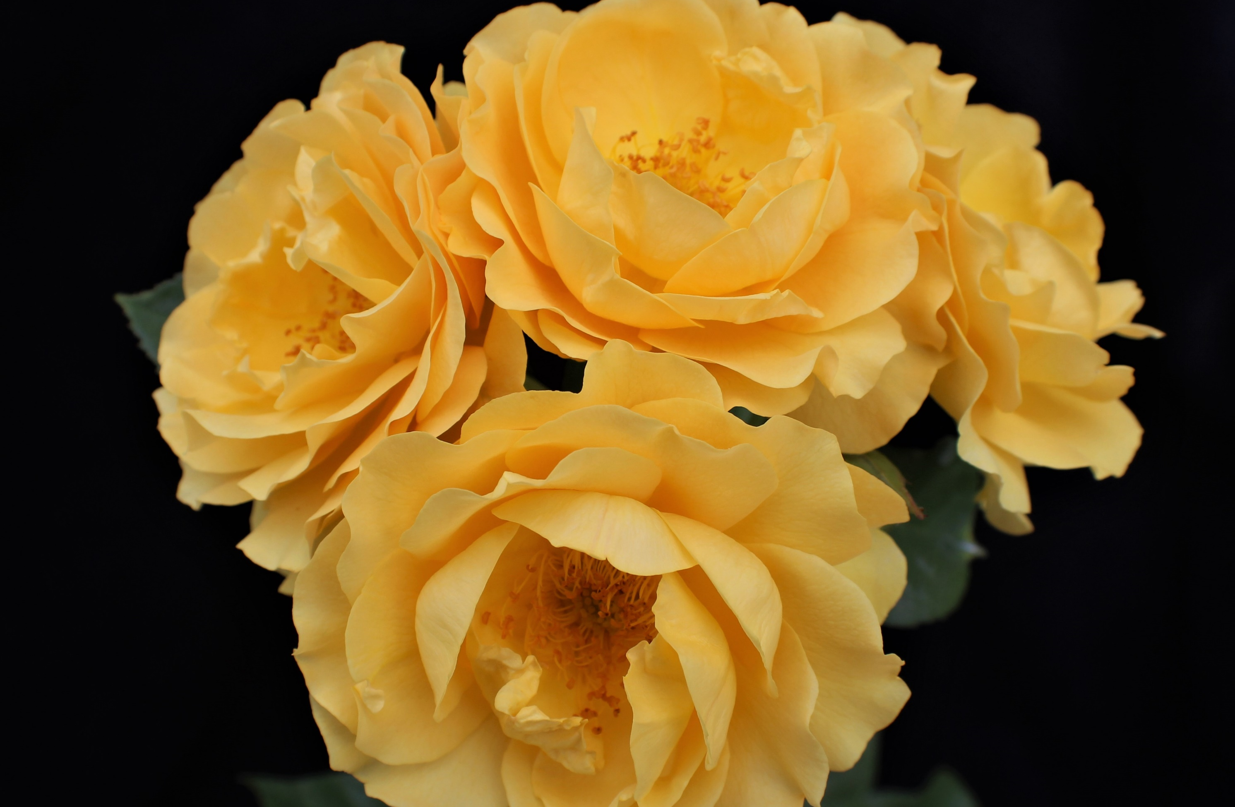
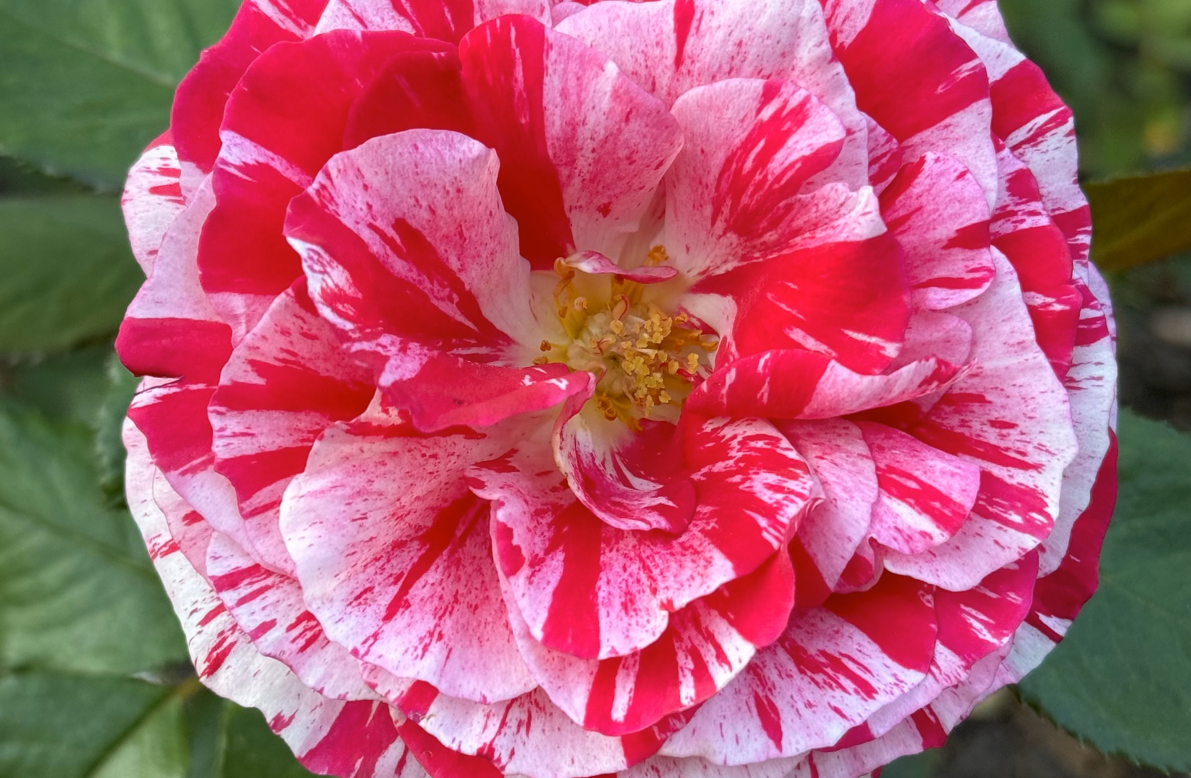
Floribunda Roses
Julia Child
8.3 5B zone
Scentimental
7.8 6A zone

Slide 9
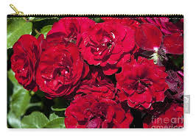

Floribunda Roses
Lavaglut
8.6 5B zone
Hannah Gordon
8.6 6A zone

Slide 10
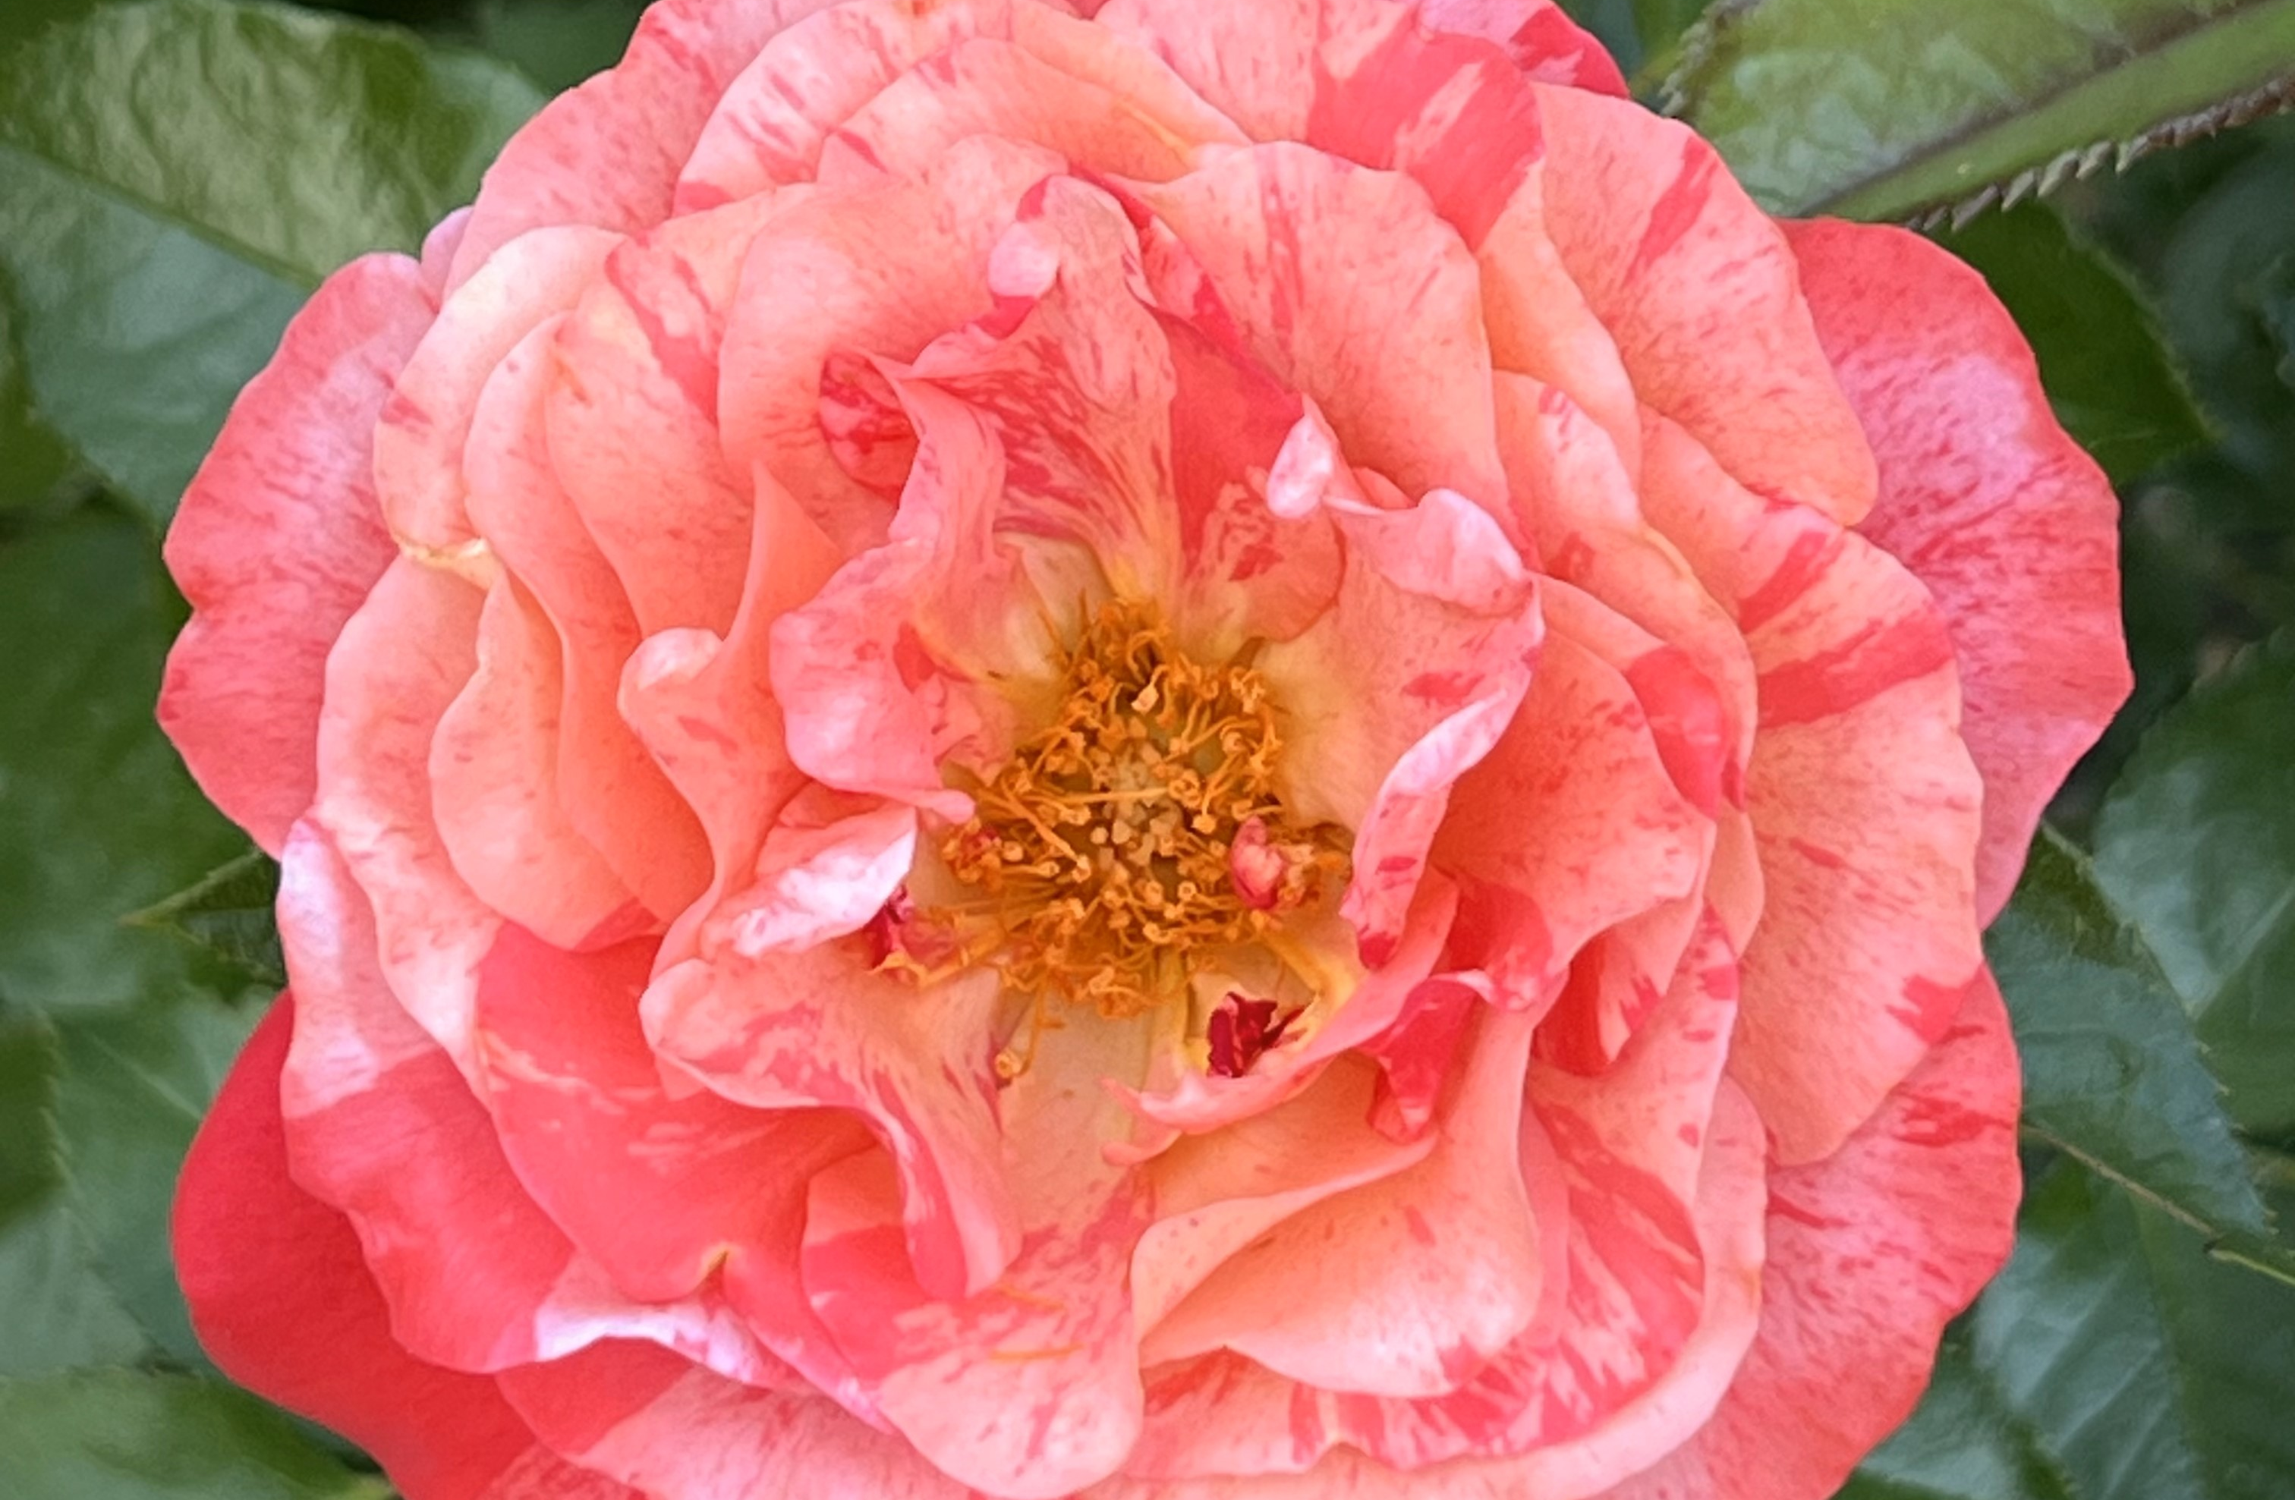
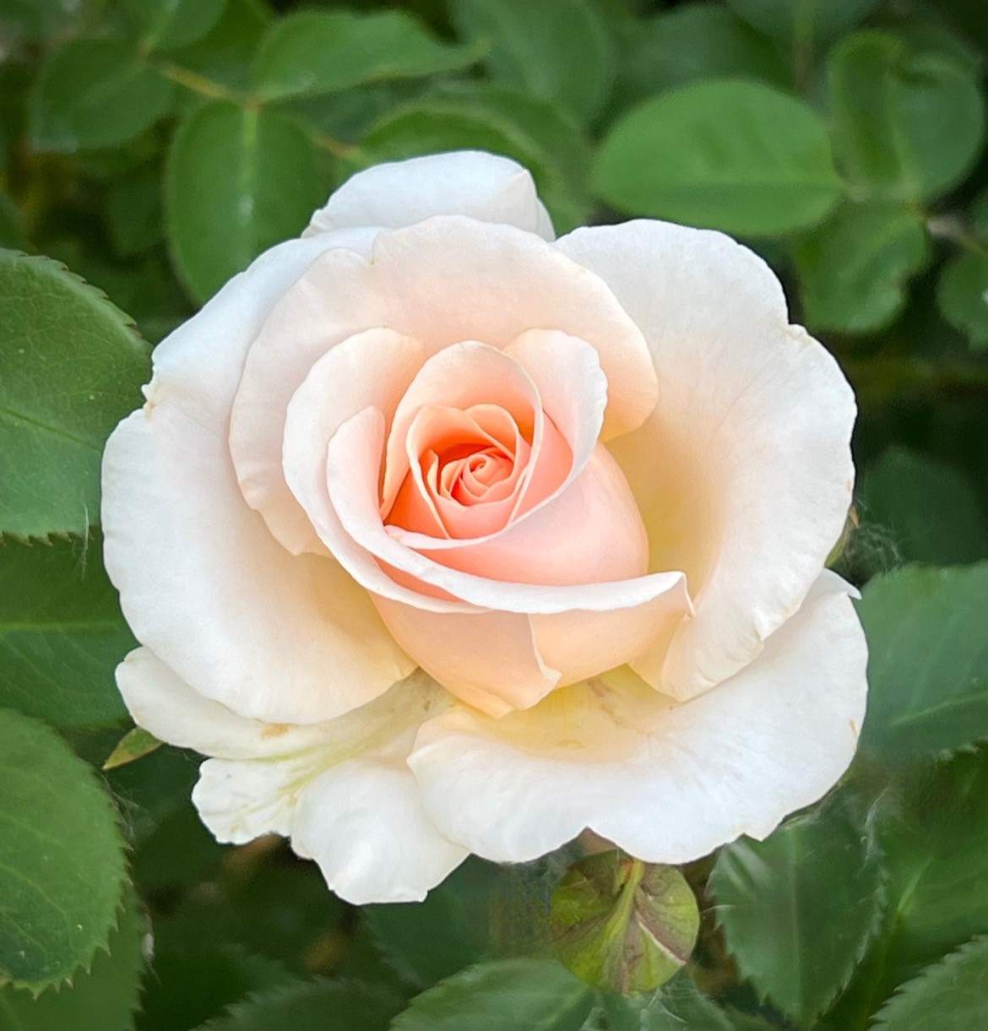
Floribunda Roses
Frida Kahlo
8.0 5A zone
Pretty Lady
8.3 6A

Slide 11
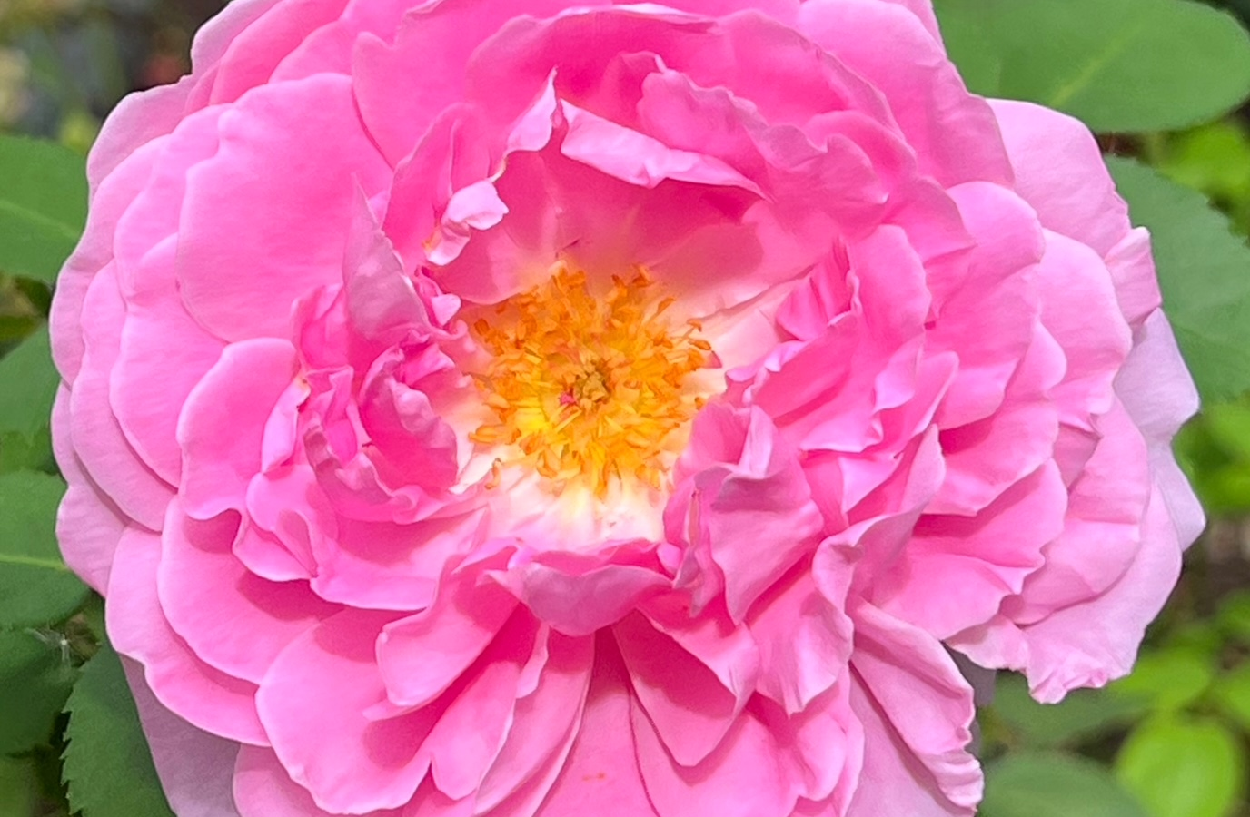

Shrub Roses
Mary Rose
8.3 5B zone
Graham Thomas
8.2 5B zone

Slide 12
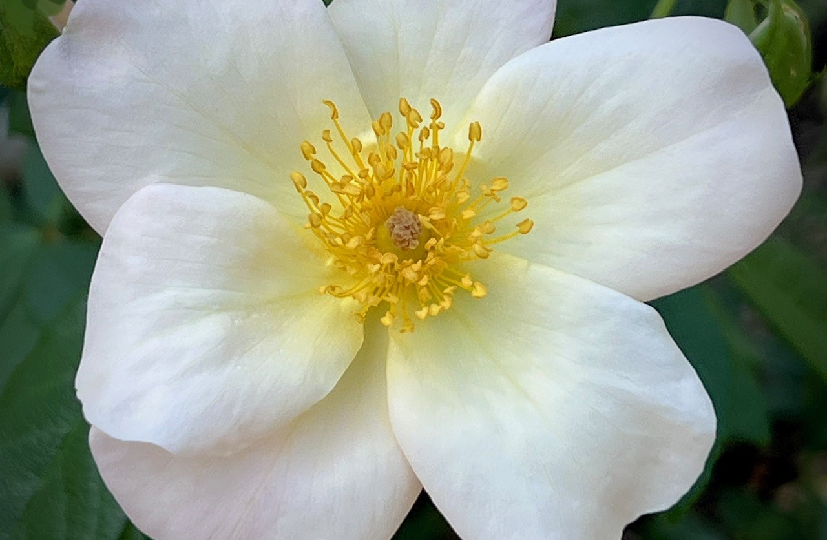

Shrub Roses
Sally Holmes
8.8 5B zone
The Fairy
8.7 4B zone

Slide 13
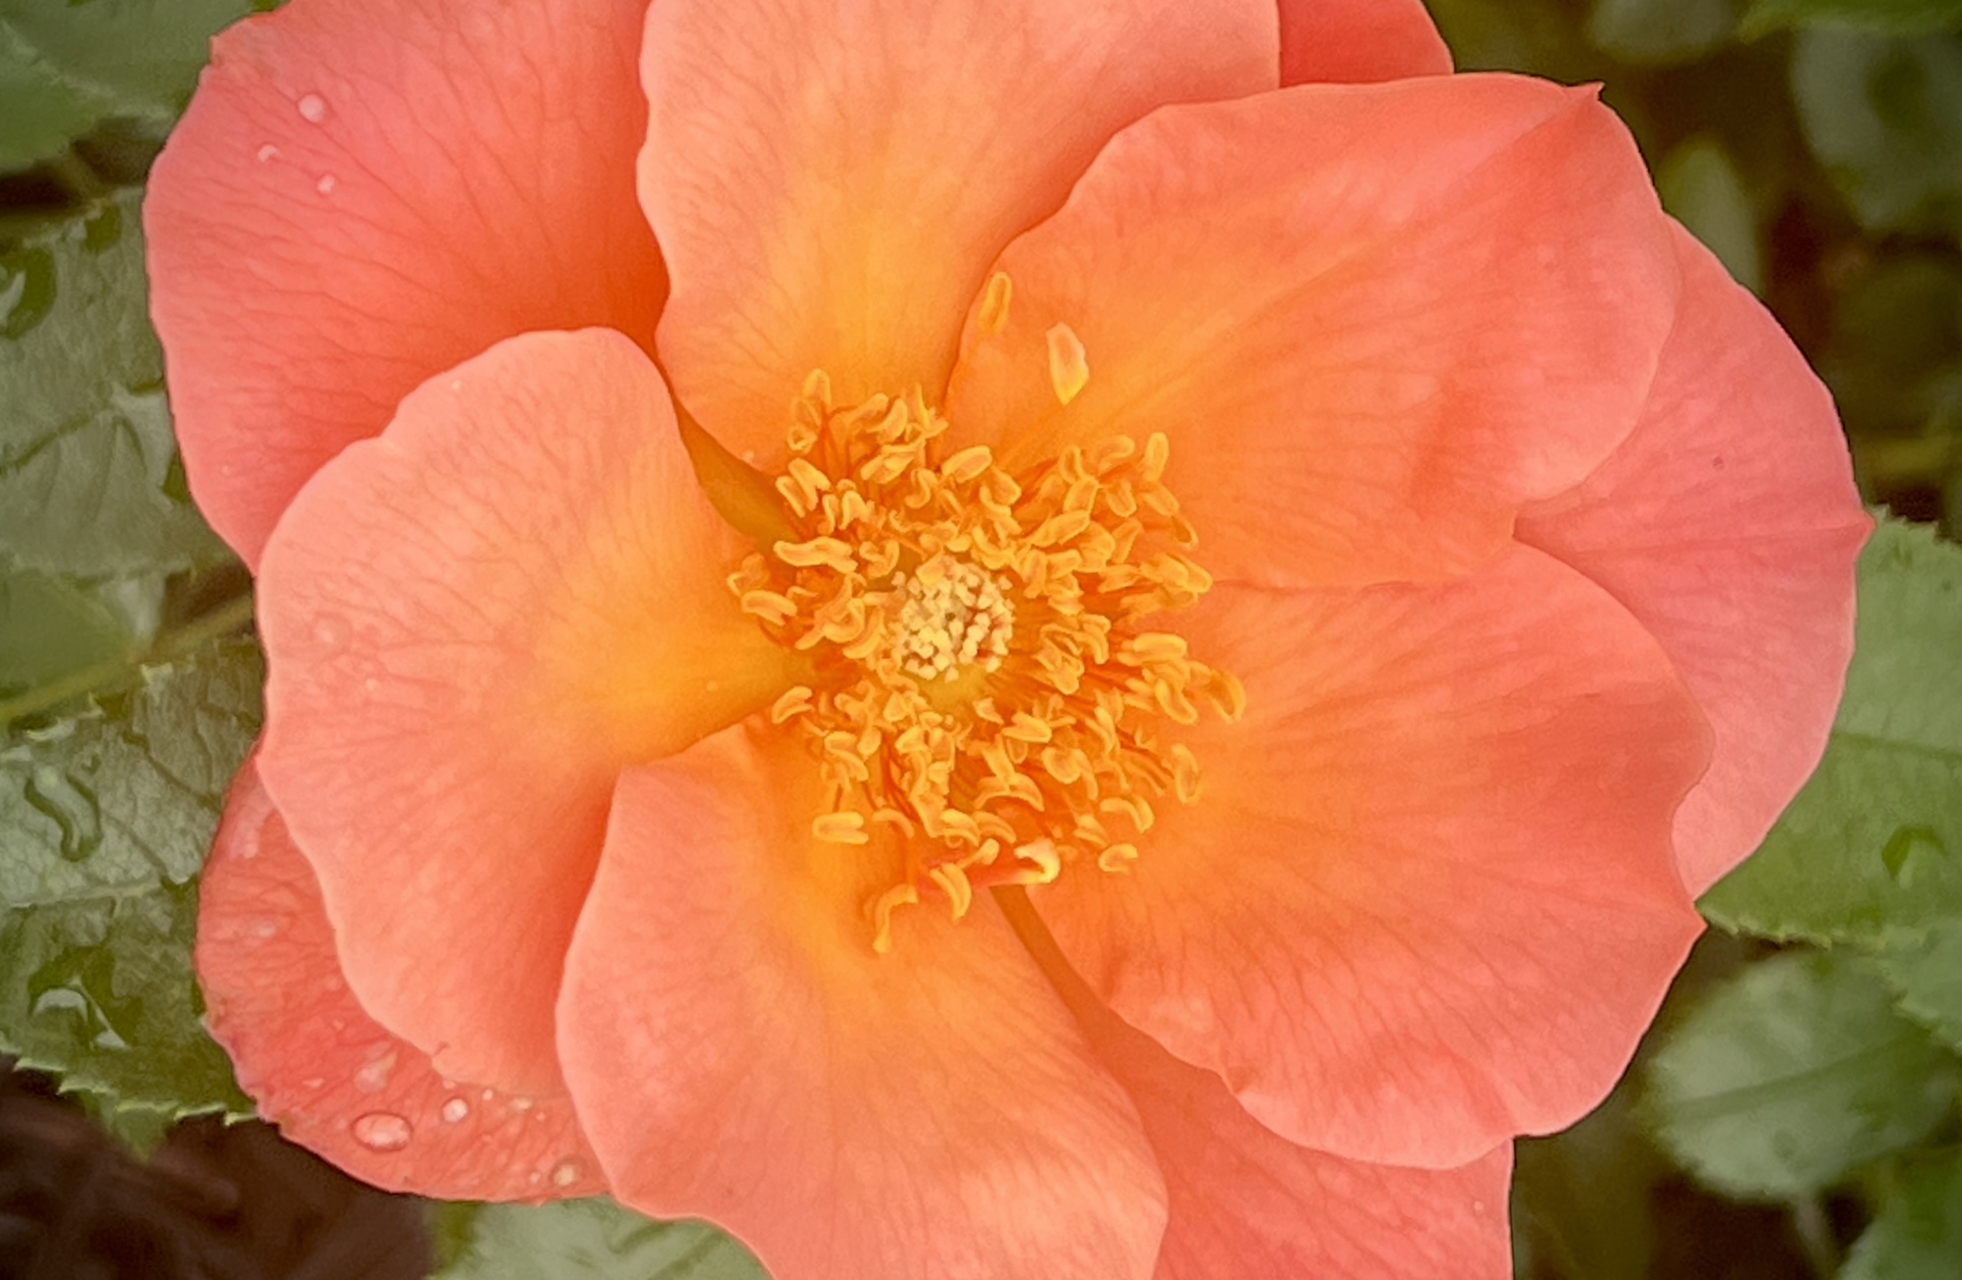
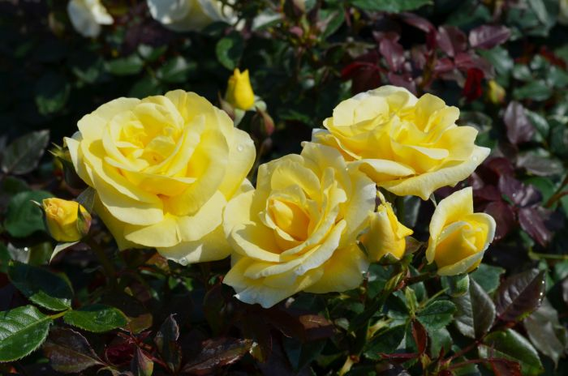
Shrub Roses
All The Rage
8.0 4B zone
High Voltage
8.7 4B zone

Slide 14
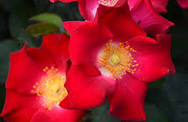
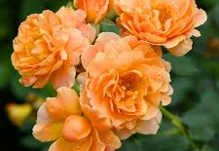
Shrub Roses
Screaming Neon Red
8.6 4B zone
At Last
7.7 5B zone

Slide 15
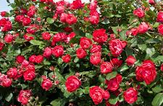
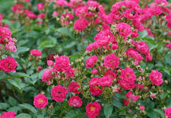
Shrub Roses
Oso Easy Double Red
4B zone
Oso Easy Peasy
4B zone

Slide 16
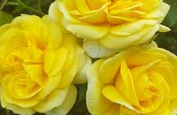
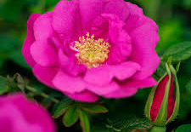
Shrub Roses
Yellow Brick Road
7.9 4B zone
Lotty’s Love
9.4 4B zone

Slide 17
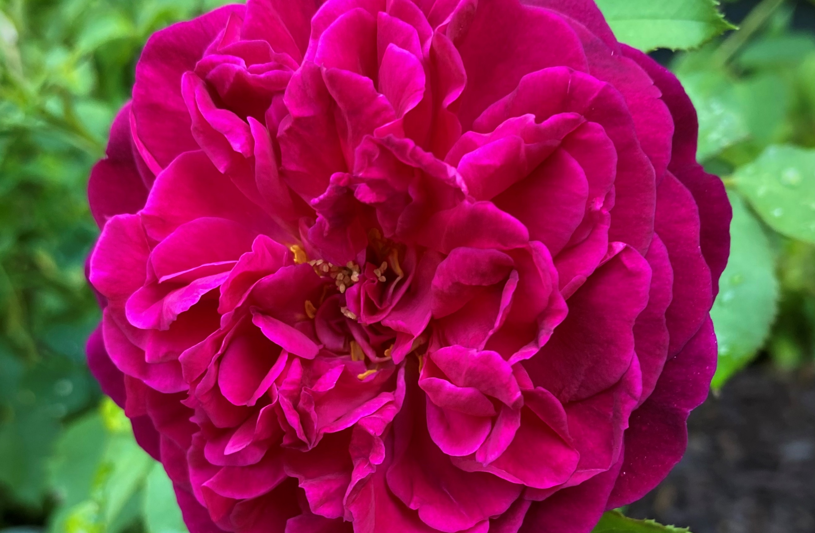
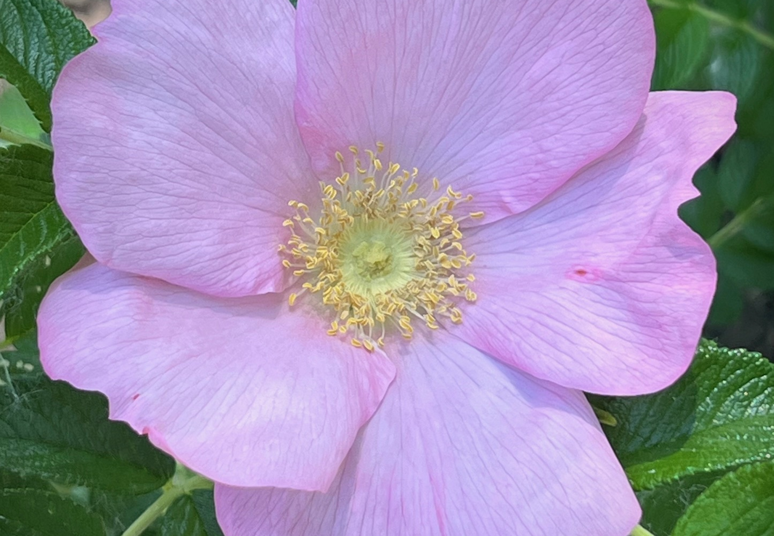
Shrub Roses
Rose de Rescht
8.7 4B zone
Dagmar Hastrup
8.4 3B zone

Slide 18
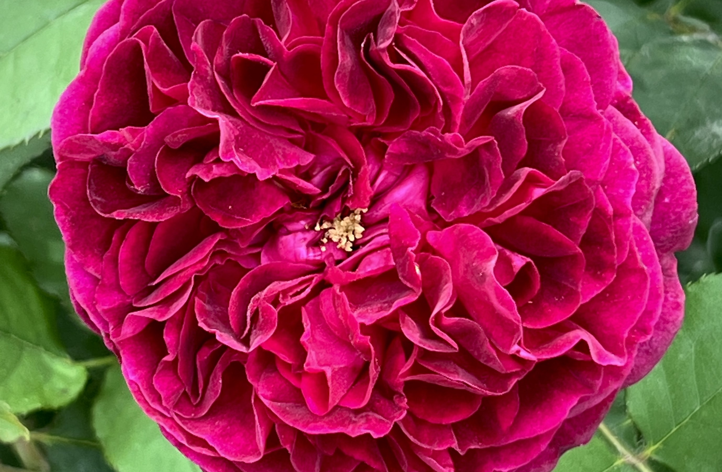
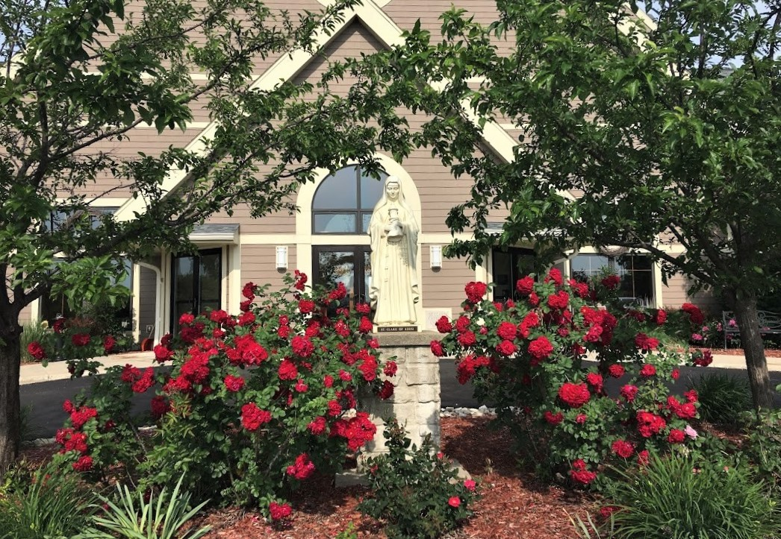
Shrub Roses
Munstead Wood
8.0 5B zone
Linda Campbell
8.3 4B zone

Slide 19
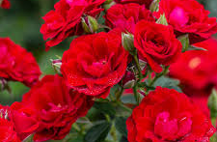
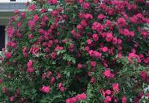
Shrub Roses
Large Flowering Climber
Cherry Frost
8.9 4B zone
John Cabot
8.7 2B zone

Slide 20
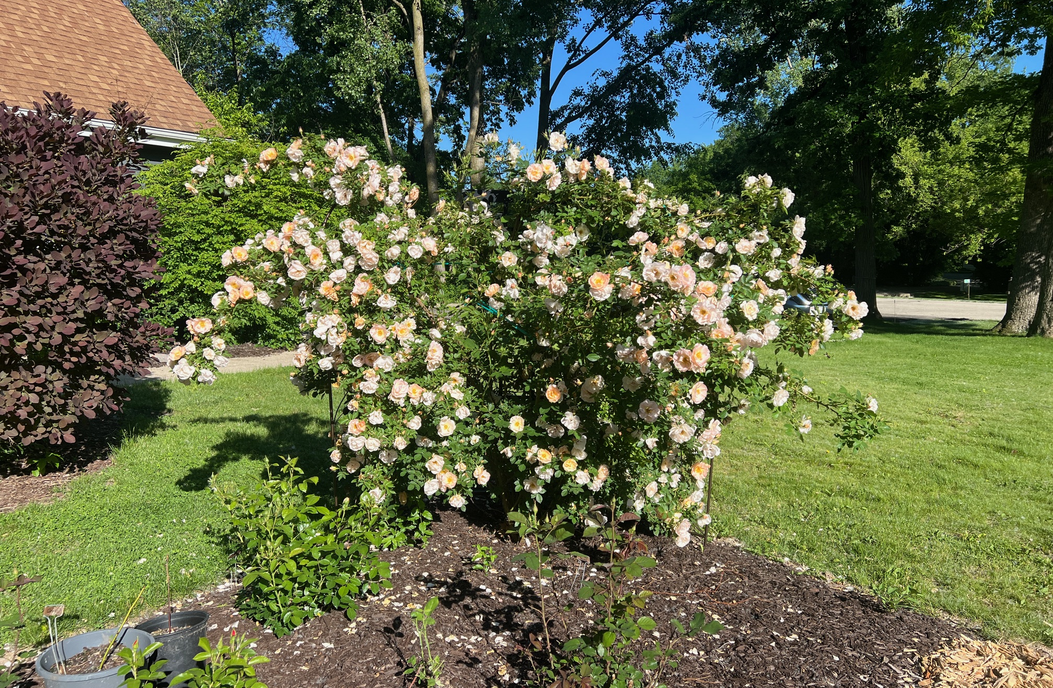
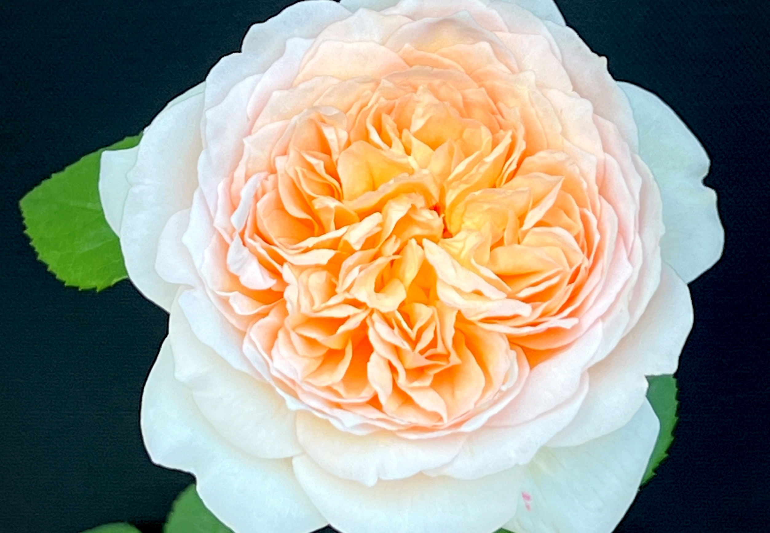
Climbing Roses
Above and Beyond
8.7 3B zone
Bathsheba
8.1 5B zone

Slide 21
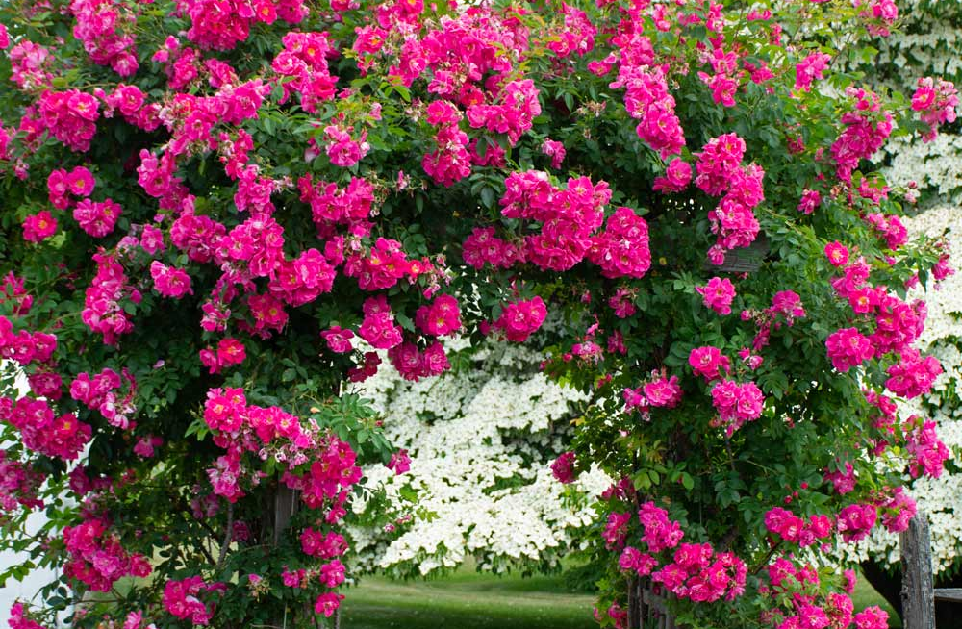
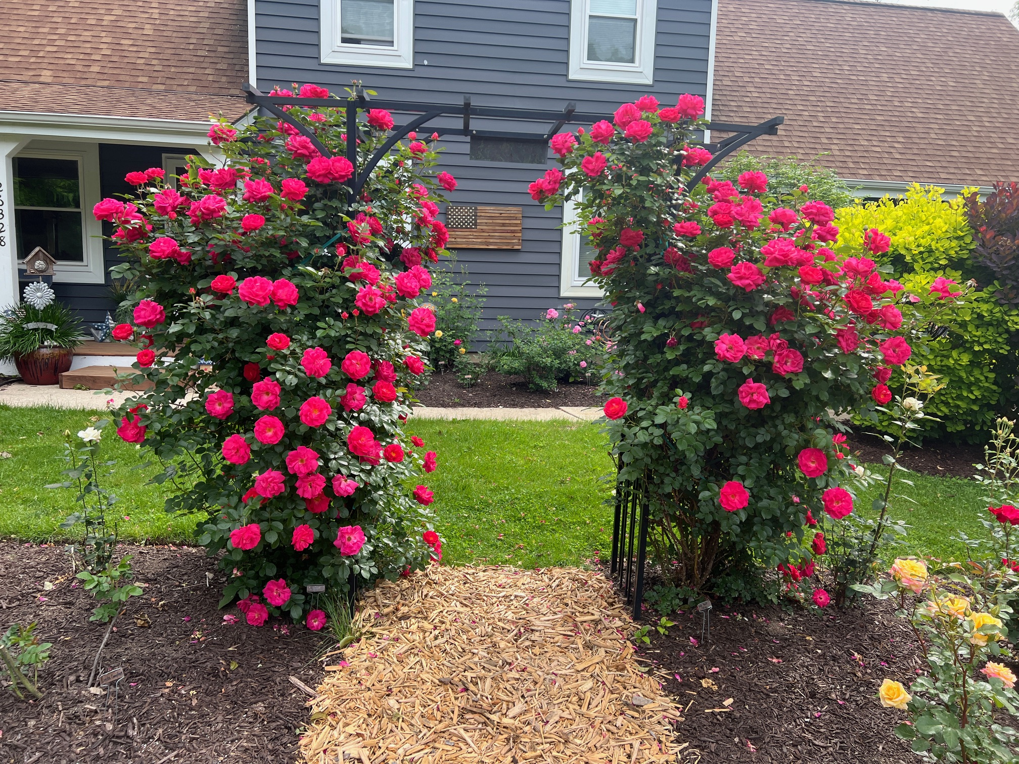
Climbing Roses
William Baffin
8.7 4B zone
High Wire Flyer
8.1 5B zone

Slide 22

Now Let’s Go Out and Grow Some Great Roses
Any Questions?

